Slide 1
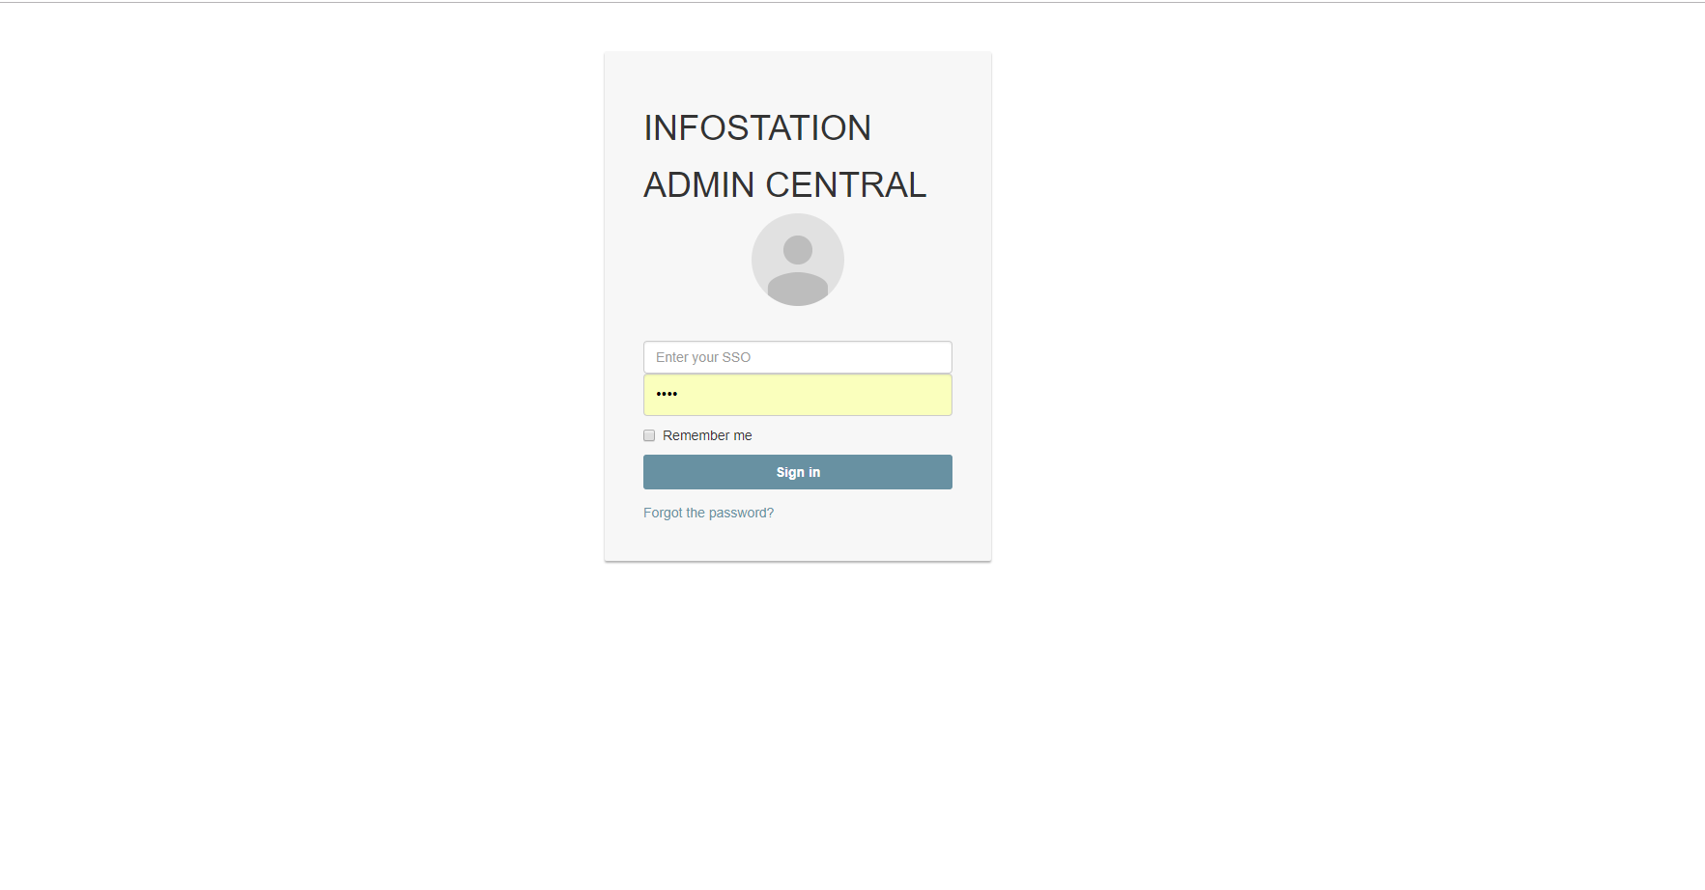
LOGIN PAGE
CLEAR
SUBMIT

Slide 2
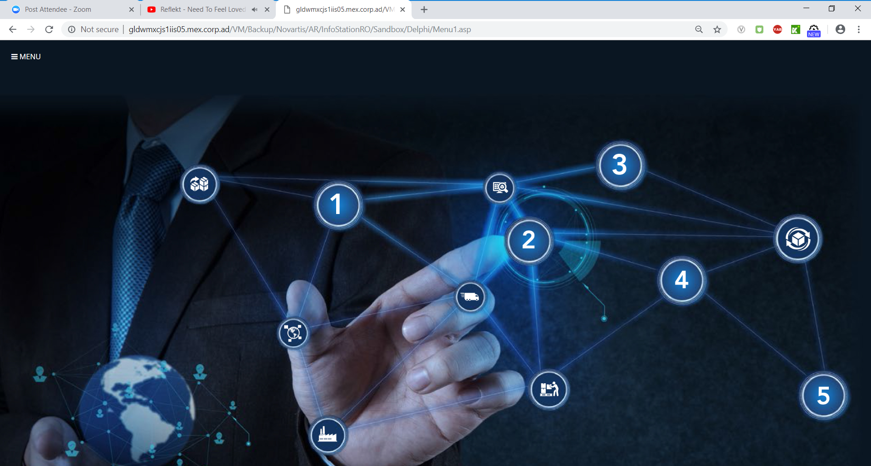

Slide 3
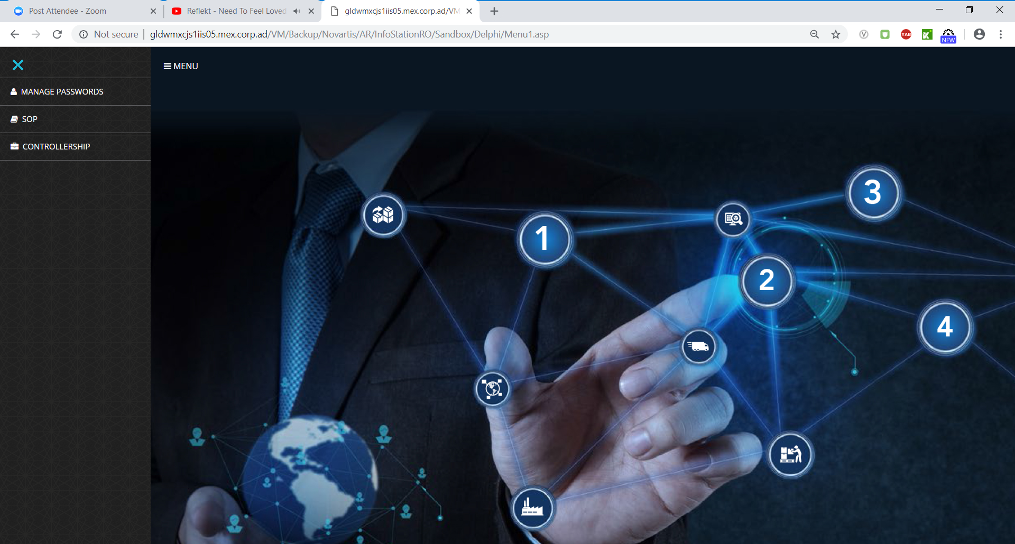
MAIN MENU
Sticky Menu

Slide 4
CREAT PROFILE PROFILE /EDIT PROFILE
MENU
NOMBRE
TEXT
APELLIDO
TEXT
EMAIL
EMAIL FIELD
CELULAR
MOBILE PHONE
Submit
Clear

Slide 5
x
TRADUCTION
PEDIDO NUEVO
NEW SHIPPING
MIS PEDIDOS
MY SHIPMENTS
REPORTES
REPORTS
GRAFICOS
CHARTS
Mi PERFIL
MY PROFILE
FAQ
FAQ
AYUDA
HELP

Slide 6
PEDIDO NUEVO
User Profile photo
MENU
USER NAME
Costo Producto $
Amount
Soporte Costo
Upload Image field
Fecha llegada
Date Field Calendar picker
Peso
Wheight (Text Field)
Kg system metric
Guia de compra
Text Field
Pago Depositado
Amount
Referencia
Text
Soporte
Upload Image field
Submit
Clear

Slide 7
MIS PEDIDOS (USER VIEW) Only DISPLAY ITS Shipments.(ADMIN VIEW CAN SEE ALL Shipments and can edit all fields)
3
2
10
MENU
Arribal Date
Only Admin can Modify this fields
EN CAMINO
PENDIENTES
RECIBIDOS
NEW SHIPMENT
Costo Producto | Soporte Producto | Fecha de Recibido | Guia de compra | Pago depositado | Referencia | Soporte | Status | Peso | GUIA DE ENVIO | PAQUETERIA | FECHA DE ENVIADO
Amount field | Image If double click image should be displayed | Date field | No. shipment(Numeric Field) | Amount Field | Reference number (Numeric Field) | Image if double click image should be displayed | SHIPPED | 10kg | NUMERIC FIELD | OPTION FIELD DHL ESTAFETA FEDEX | SENT DATE (Date Field)
Borrar
Modificar
Modify button allows you to modify input fields. Or delete the shipment. Ask to confirm to delete a shipment
Row should be green or red (not intense red) if actual date is 3 days greater than Arrival Date or green if is less than 3 days should be green (use pastel colors)

Slide 8
REPORTES
MENU
DATE PICKERS
15,00.00
PROFITS
DROP DOWN TO FILTER BY STATUS (ENVIADO/PENDIENTE)
If the status is Entregado the profits should sum up the pago depositado in order to know the Earnings.
FROM
TO
FILTERS
STATUS
Submit
Clear
USER
LIST ALL USERS WITH EXISITING RECORDS.

Slide 9
ADMIN DASHBOARD
MENU
2
4
4
4
4
EN CAMINO
PENDIENTES
NEW CLIENTS
AVERAGE SHIPPING
OUT OF TAT
Should be calculated taking into account the open shiments that arrival date (fecha de recibido) is less than today’s date.
Should be calculated taking into account the open shiments that arrival date(fecha de recibido is greater than today;s date
Count New Cients that created their profile in the current month.
Monthly Average TAT time Average between Fecha Recibido – Fecha de Envio)
Monthly Average TAT time Average all the Shipments with output of Substract Fecha de Recibido-Fecha de Envio Greater than 3 days
DAILY VOLUME CHART
MONTLY VOLUME CHART
MONTLY EARNINGS CHART
COUNT ALL SHIPMENTS BY DAY
COUNT ALL THE SHIPMENTS GROUPED BY MONTH
SUM ALL THE AMOUNTS IN FIELD “PAGO DEPOSITADO” CURRENT MONTH/YEAR

Slide 10
FAQ FREQUENT QUESTIONS
Admin can edit the questions and answers.
MENU
COMO CREAR UN PEDIDO?
COMO SABER CUANTO DEBO DE DEPOSITAR?
CUANDO LLEGA MI ENVIO?
QUE PAQUETERIA LLEGARIA MI ENVIO?

Slide 11
AYUDA
MENU
Modal window
X
Si necesita ayuda o mas Informacion puede hablar al siguiente telefono 656-660-11-82 o al correo ventas@dropshipeando.com

